Slide 1


Waze User Churn Prediction Case Study

Slide 2
PROBLEM OVERVIEW
Waze is a free navigation application that makes it easier for drivers to get where they need to go safely. The Waze app is powered and used by drivers all over the world. As a community-based traffic and navigation app, and was created as a social navigation tool for cars
Churn is the business term that describes how many customers stop using a product or service, or stop doing business with a company altogether and at what rate this occurs
Typically, high retention rates indicate satisfied users who repeatedly use Waze app over time. Developing a churn prediction model will help prevent churn, improve user retention, and grow Waze’s business. An accurate model can also help identify specific factors that contribute to churn

Slide 3
OBJECTIVE
Our objective for this case study is to apply Machine Learning and Predictive analytics to ;
Develop a churn prediction model will help prevent churn, improve user retention, and grow Waze’s business.
Empower the Waze leadership to make data-driven decision making by offering key insights and data-informed recommendations.
Analyze and interpret data, generate actionable insights, and help leadership make informed business decisions.
Proactively identify factors that will engage high-risk churn users to retain them.
We'll build both classification and regression predictive analytics models to predict;
User churn is measured by the number of users who have either uninstalled the app or stopped using the app.
Driven km’s is the total number of driven kilometers by users

Slide 4
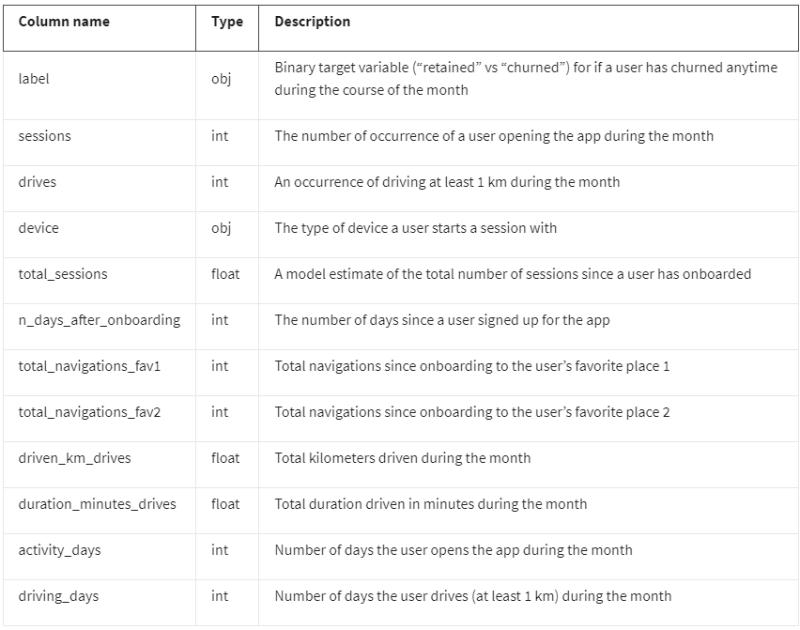
Data Dictionary

Slide 5
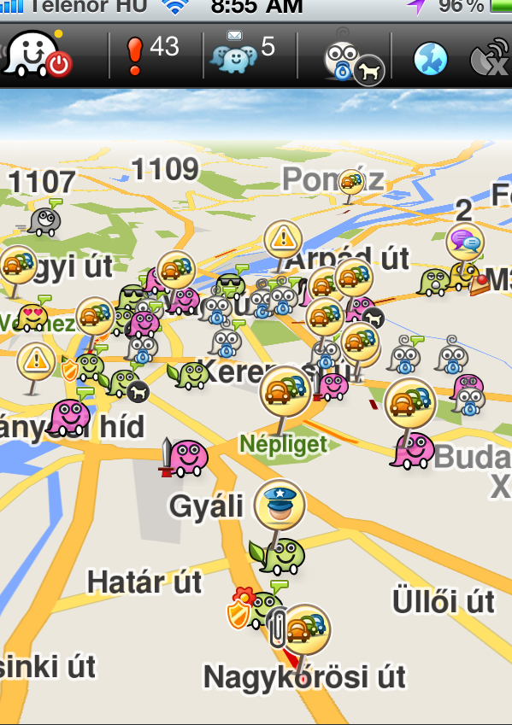
This dataset is supplied by Google. According to Google, this dataset contains synthetic data created in partnership with Waze. For educational purposes and uses.
Data Source:

